Slide 1
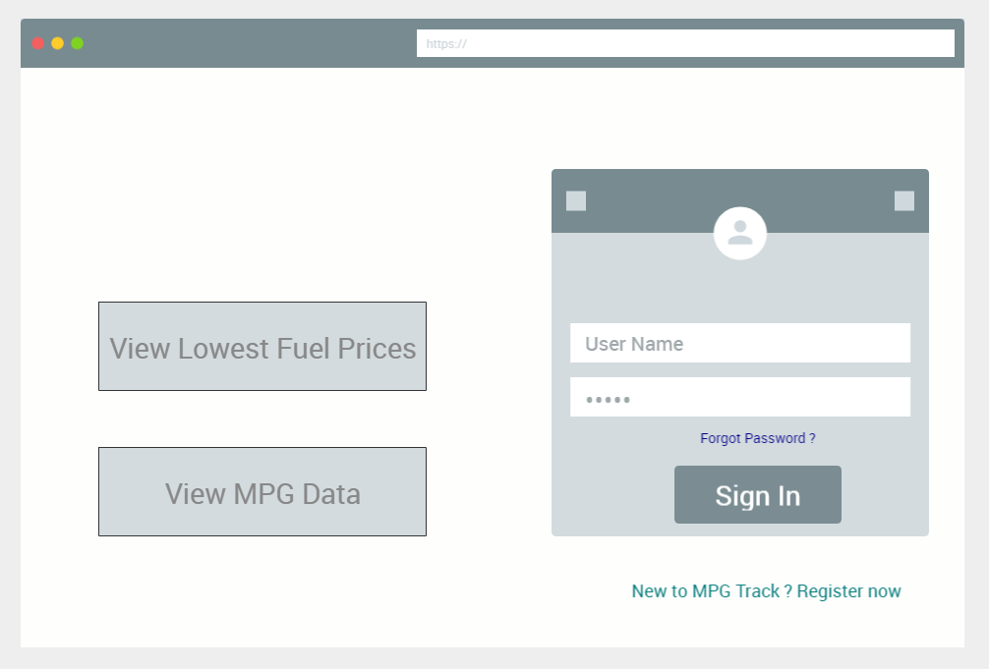

Track
MPG

Slide 2
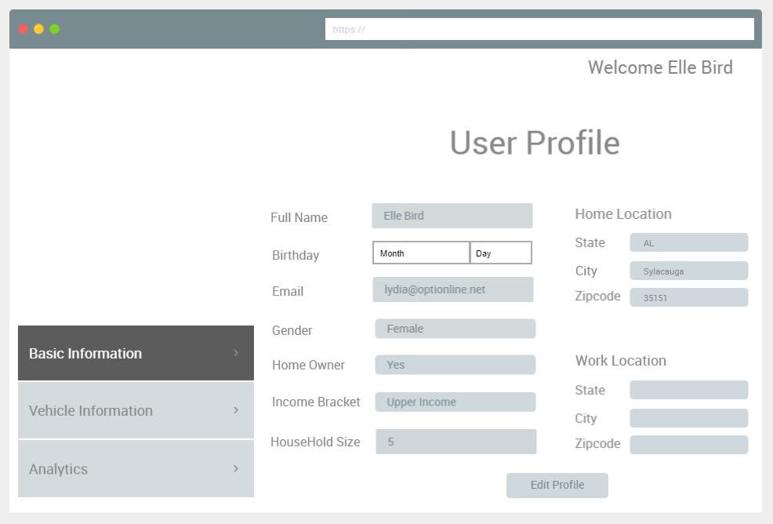
Track
MPG

Slide 3
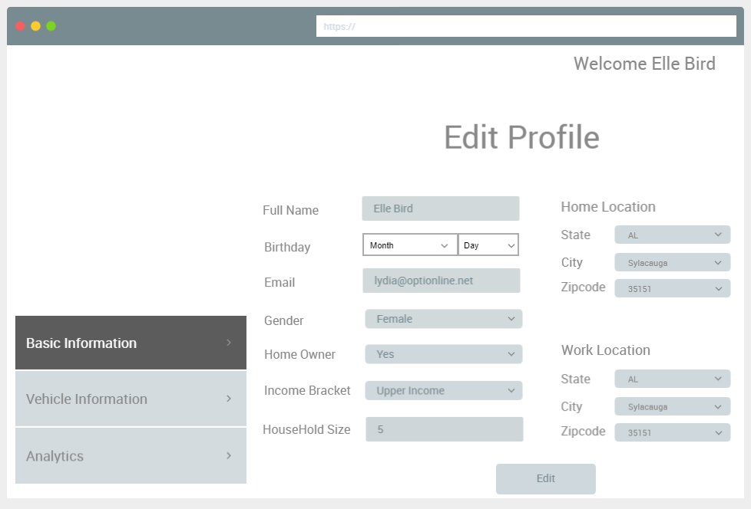
Track
MPG
No

Slide 4
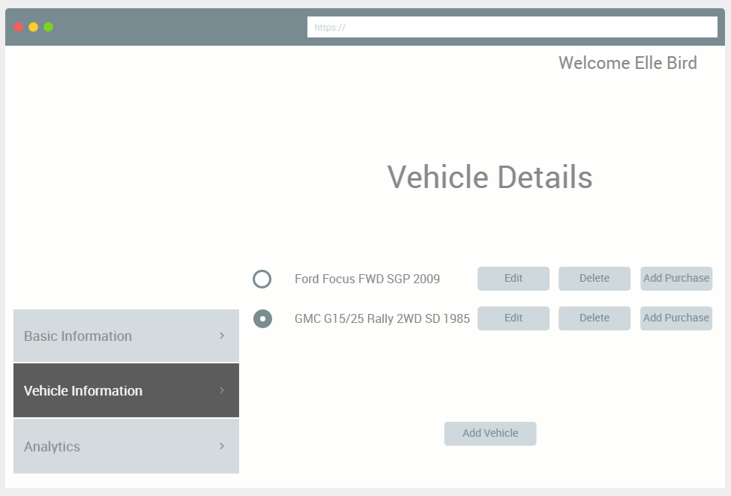
Track
MPG

Slide 5
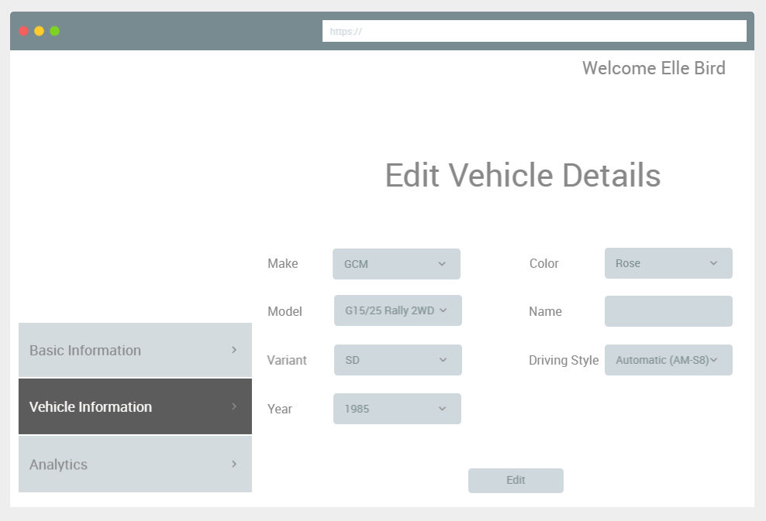
Track
MPG

Slide 6
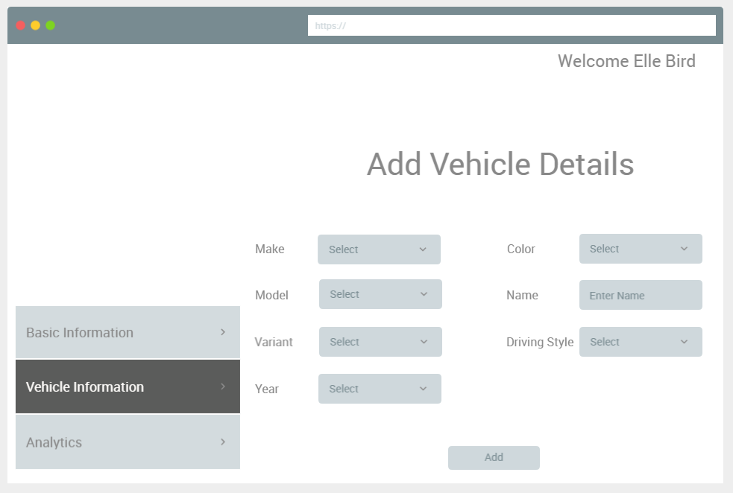
Track
MPG

Slide 7
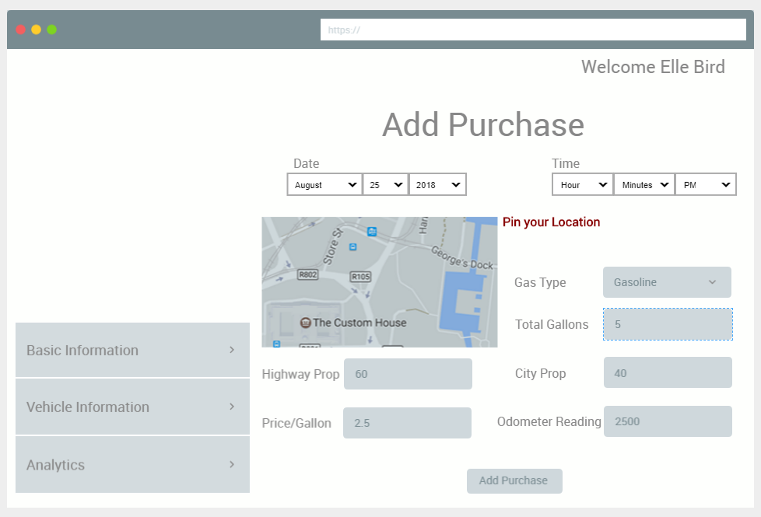
Track
MPG

Slide 8
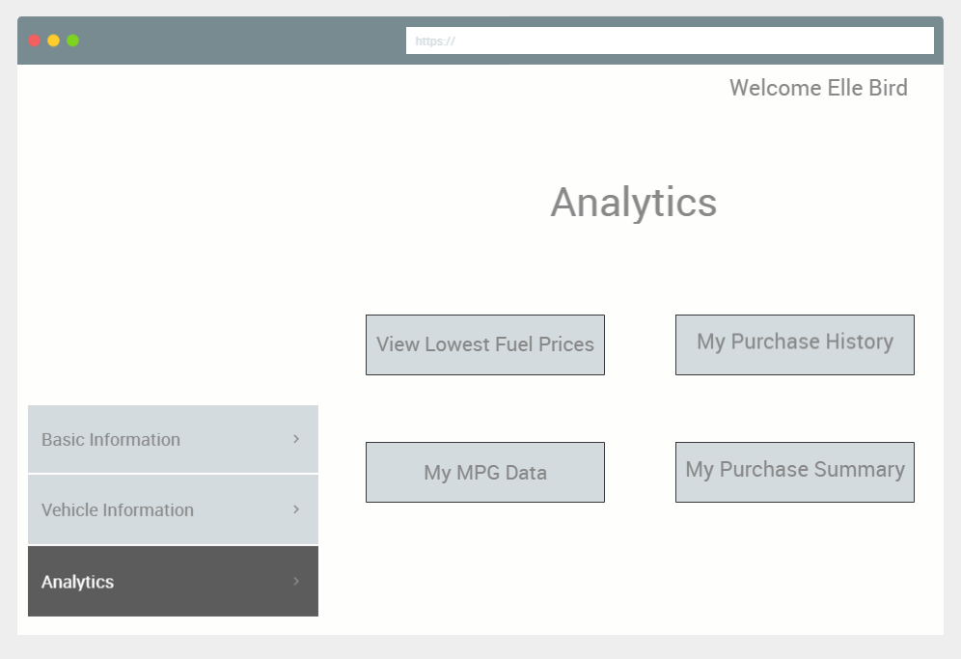
Track
MPG

Slide 9
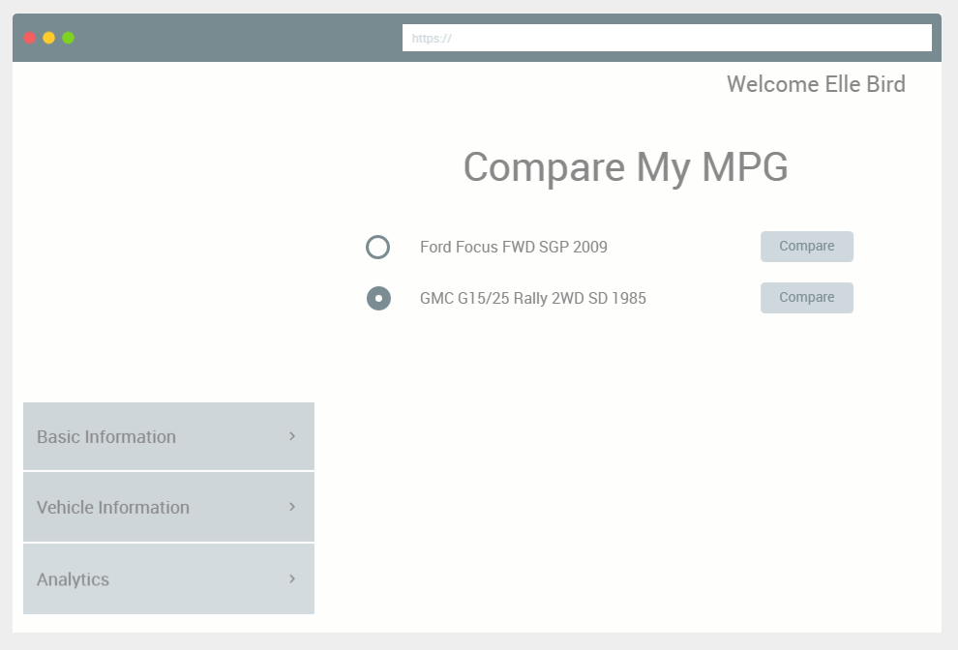
Track
MPG
Your Vehicle MPG | Total Gallons Used | Total Miles Driven | Total Amount Spent
138.56 | 72 | 11020 | 165.56
User Vehicle MPG | Total Amount Spent | Avg. City Proportion | Avg. Highway Proportion
68.96 | 465.42 | 59.95 | 40.05

Slide 10
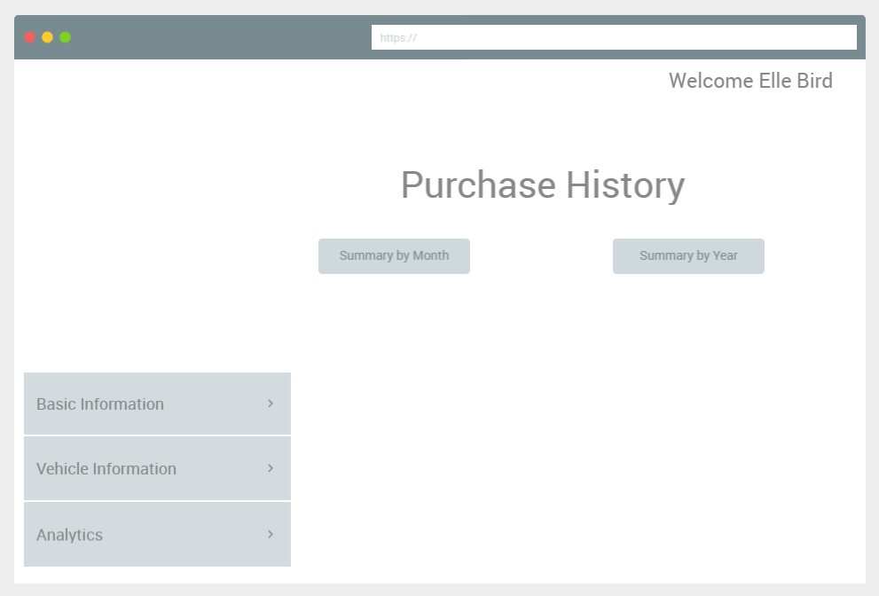
Track
MPG
Vehicle | Gas Type | Date | Odometer Reading | Price/ Gallon | Total Gallons
Ford Focus FWD 2009 | Diesel | 4/22/2018 | 4800 | 0.91 | 5
Ford Focus FWD 2009 | Diesel | 4/23/2018 | 4810 | 3.89 | 14
Ford Focus FWD 2009 | Diesel | 4/24/2018 | 4820 | 1.74 | 13
Ford Focus FWD 2009 | Diesel | 4/21/2018 | 4790 | 1.97 | 15
Ford Focus FWD 2009 | Diesel | 4/25/2018 | 4830 | 2.98 | 6
Ford Focus FWD 2009 | Diesel | 4/26/2018 | 4840 | 2.93 | 9
Ford Focus FWD 2009 | Diesel | 4/27/2018 | 4850 | 0.91 | 16
GMC G15/25 Rally 2WD 1985 | Gasoline | 12/31/2018 | 11020 | 2.72 | 15
GMC G15/25 Rally 2WD 1985 | Gasoline | 12/26/2018 | 10950 | 2.27 | 10
GMC G15/25 Rally 2WD 1985 | Gasoline | 12/30/2018 | 10990 | 2.32 | 3
GMC G15/25 Rally 2WD 1985 | Gasoline | 12/30/2018 | 11000 | 1.75 | 16
GMC G15/25 Rally 2WD 1985 | Gasoline | 12/30/2018 | 11010 | 2.13 | 13
GMC G15/25 Rally 2WD 1985 | Gasoline | 12/27/2018 | 10960 | 3.67 | 7
GMC G15/25 Rally 2WD 1985 | Gasoline | 12/28/2018 | 10970 | 2.51 | 2
GMC G15/25 Rally 2WD 1985 | Gasoline | 12/29/2018 | 10980 | 1.47 | 6

Slide 11
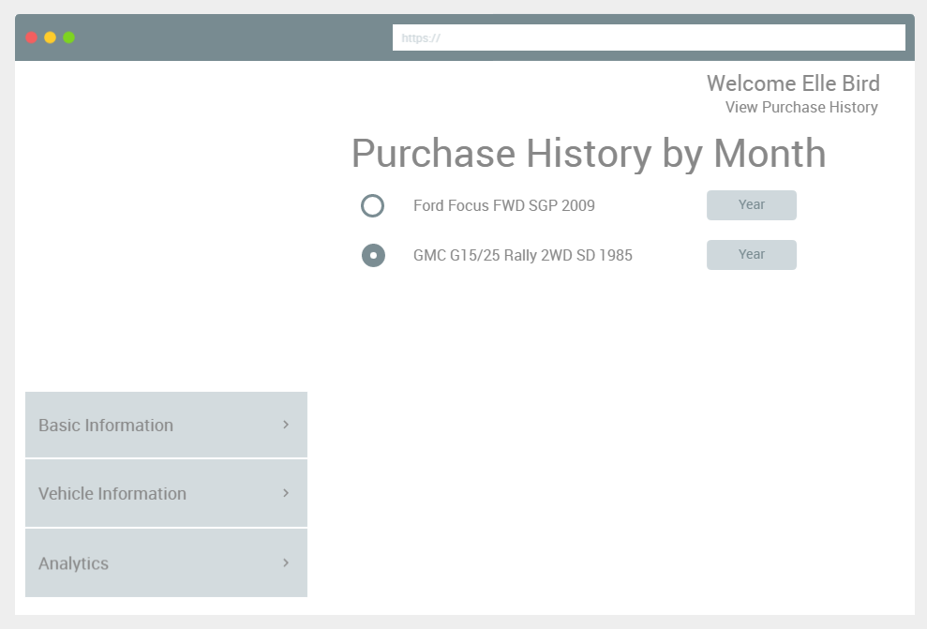
Track
MPG
Month | Odometer Reading | Total Gallons | Total Amount
December | 11020 | 72 | 165.56

Slide 12
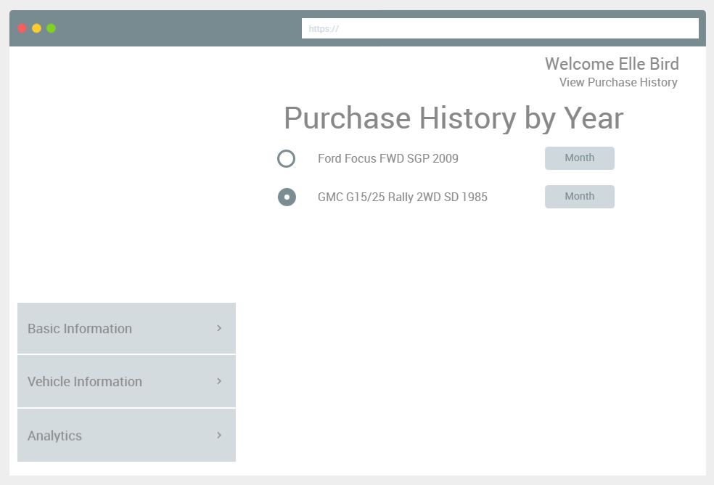
Track
MPG
Year | Odometer Reading | Total Gallons | Total Amount
2018 | 11020 | 72 | 165.56

Slide 13
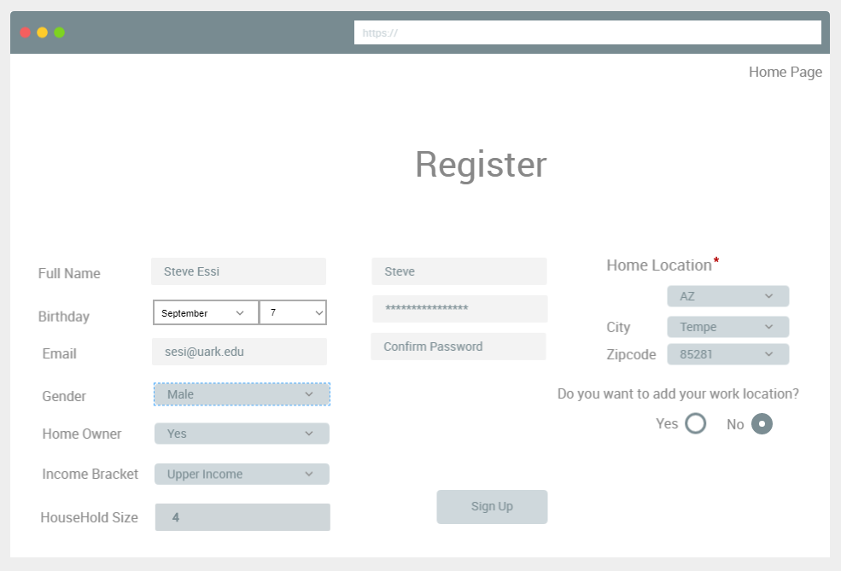
Track
MPG
Track
MPG

Slide 14
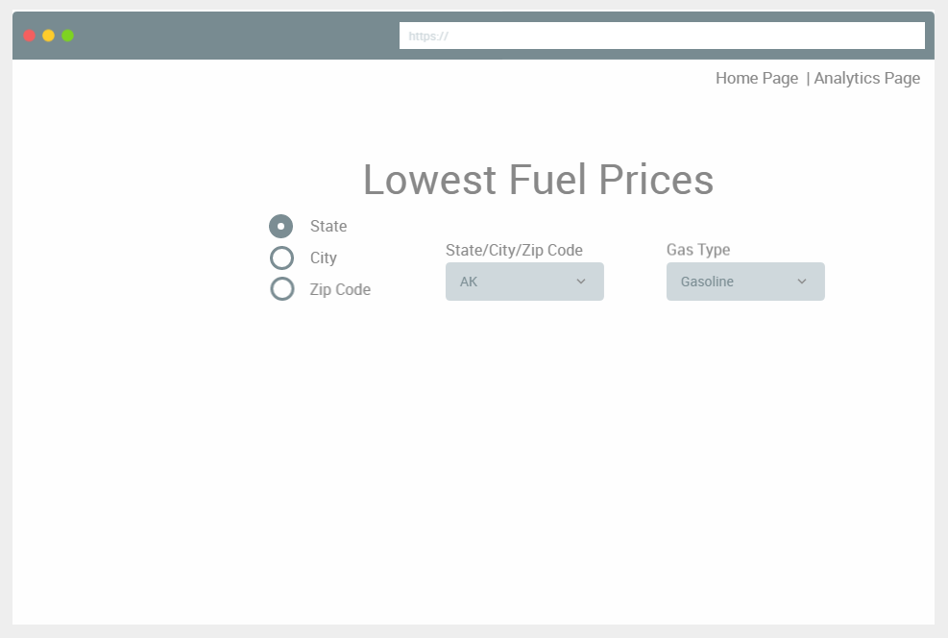
Track
MPG
Gas Station Name | Lowest Price
Spirit Petroleum_Hartsdale | 2.02

Slide 15
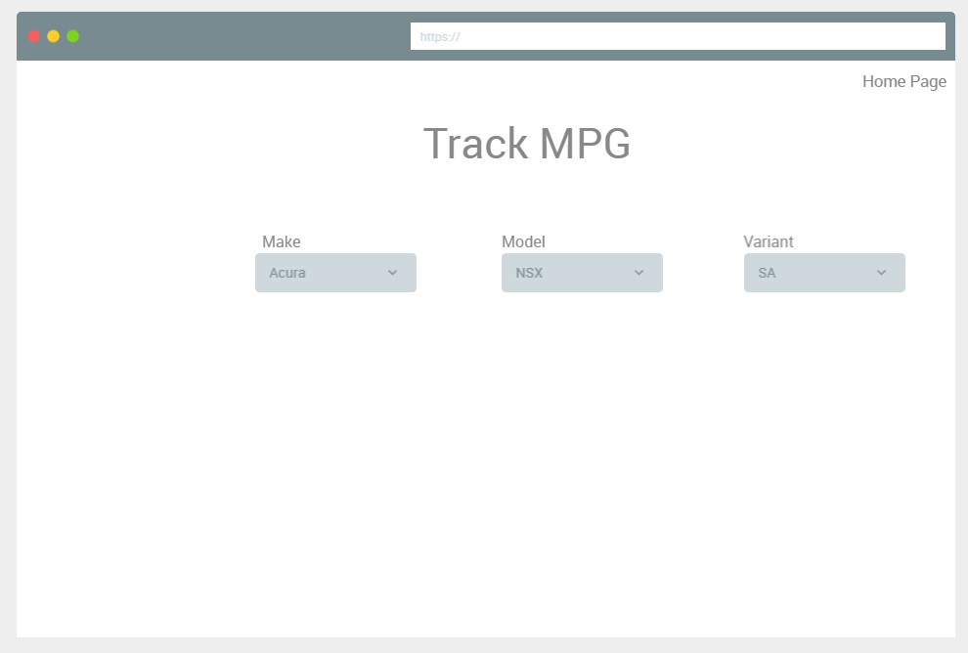
Track
MPG
Average MPG | 26.42

